Slide 1
Chongqing University of Technology
ATAI
Advanced Technique of Artificial Intelligence
Chongqing Unive
Improving Empathetic Response Generation by
Recognizing Emotion Cause in Conversations
Code： https://github.com/Lionel-coder/EmpDialogue_RecEC
（EMNLP-2021)
Reported by Yidan Liu and Zicong Dou

Slide 2
Chongqing University of Technology
ATAI
Advanced Technique of Artificial Intelligence
Chongqing University of Technology
1. Introduction
2. Approach
3. Experiments
4. Conclusion

Slide 3
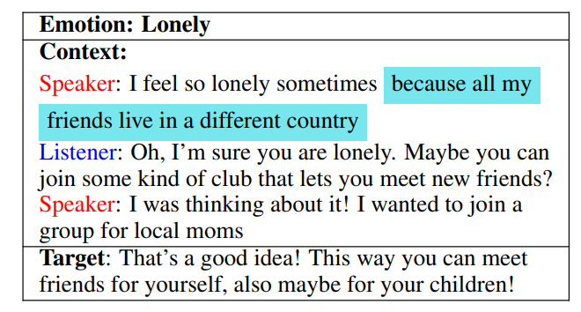
Introduction

Slide 4
Introduction
• An emotion reasoner is designed to recognize the context emotion of the speaker and the emotion cause behind the emotion, providing deep emotional information for response generation.
• We devise a gated attention mechanism and explore both hard and soft gating strategies, which allow the model to focus on emotion cause related words.
• Experiments show that incorporating emotion cause information improves the performance of the model on both emotion recognition and response generation.

Slide 5
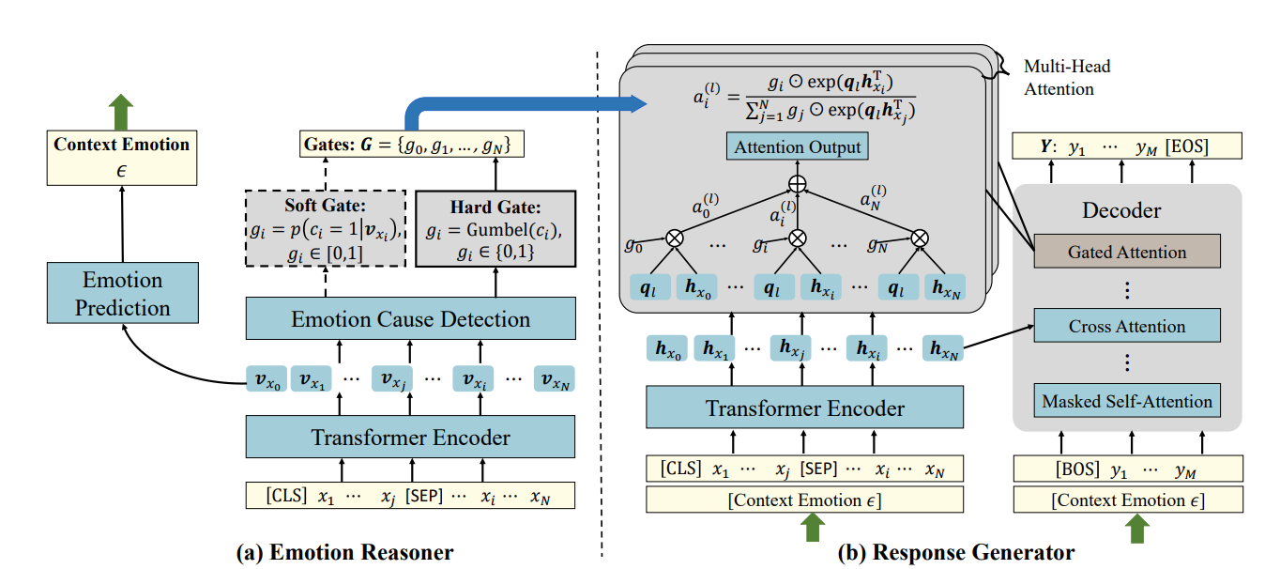
Approach

Slide 6
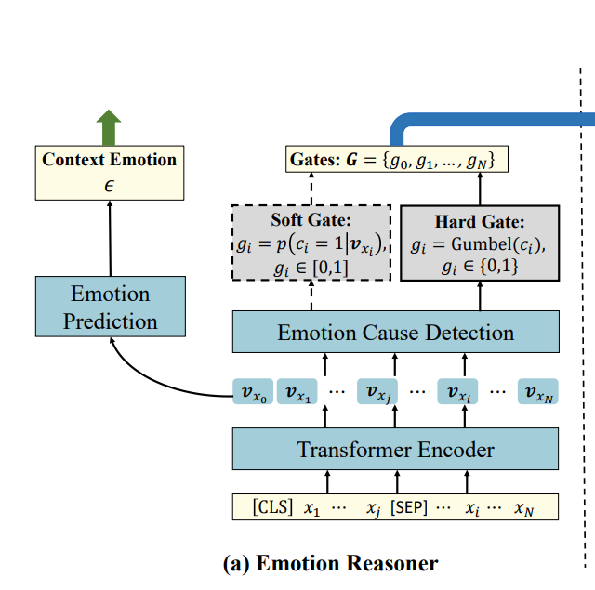
Approach
Emotion Reasoner

Slide 7
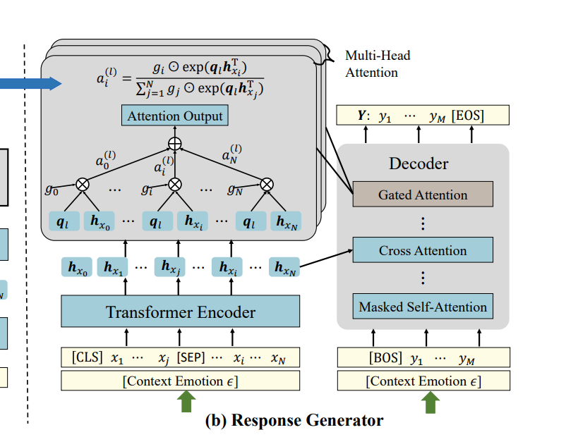
Approach
Response Generator
word embedding
positional embedding
emotion embedding

Slide 8
Approach
Response Generator

Slide 9
Experiments

Slide 10
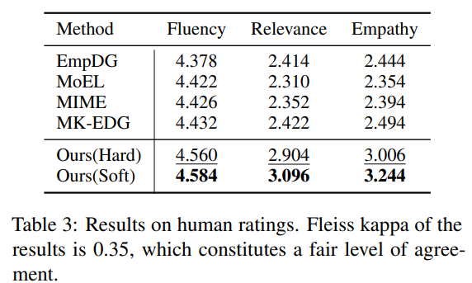
Experiments

Slide 11
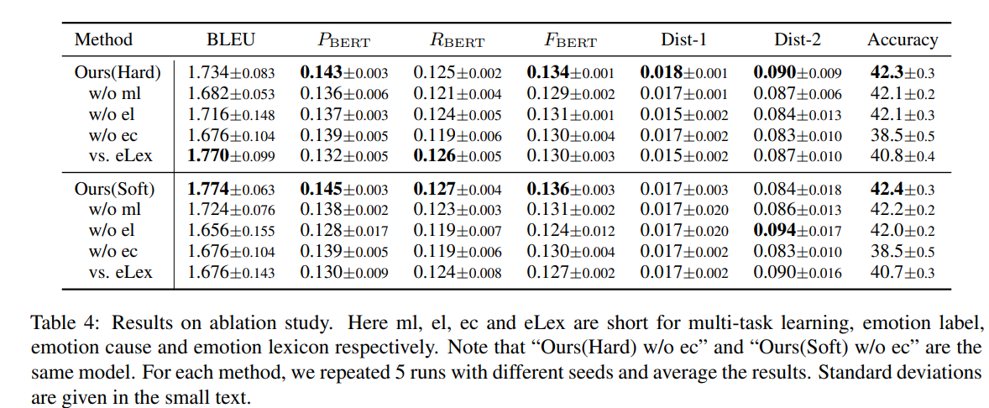
Experiments

Slide 12
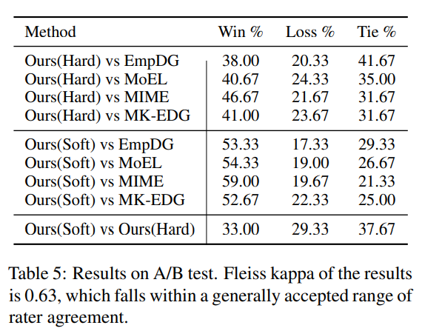
Experiments

Slide 13
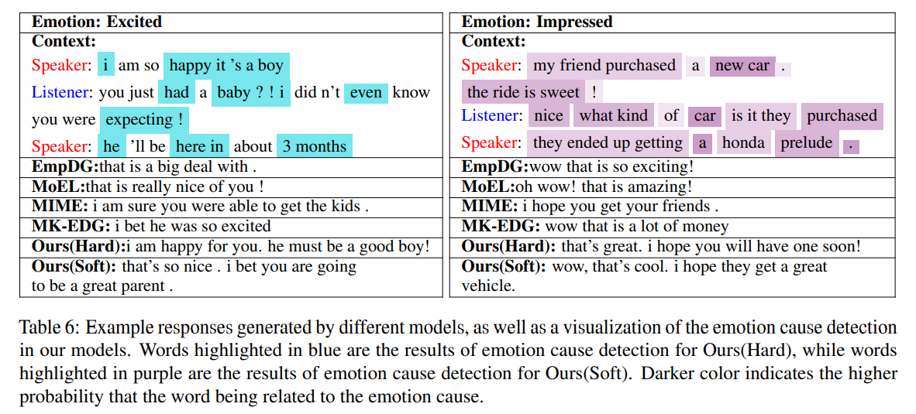
Experiments

Slide 14
Conclusion
The emotion reasoner predicts a context emotion label and locating the words in the dialogue context which are associated with the emotion cause. The response generator generates a response with the emotion label and the cause information. We devise a gated attention mechanism and explore both hard and soft gating strategies.

Slide 15
Thank you！

